Slide 1

Basic linux investigation
Linux development eviroment
May 09, 2017
Gstreamer project, Multimedia fw team,
R-Car Software Solution 2 group
Renesas design vietnam co., ltd.
Renesas Electronics Corporation

Slide 2
Basic linux investigation
Linux development eviroment
Name: huynh quoc hoang
Mentor: ha thuc anh

Slide 3

Agenda
Embedded Linux Page 4
Embedded Linux development environment Page 7
Cross-compiling toolchains Page 8
Boardloaders Page 12
Linux Kernel Page 18
Linux Root filesystem Page 28
Block filesystem Page 39

Slide 4

EMBEDDED LINUX INTRODUCTION
Linux is a clone of the operating system Unix.
A program with desire free license, grant for both commercial and non-commercial, software can be modified and distributed to customer, also good match for embedded system.
When Unix-like operating system kernel combine with GNU software and many open-source components was making Embedded Linux.
Embedded Linux is the usage of the Linux kernel and various open-source components in embedded systems

Slide 5
EMBEDDED LINUX ADVANTAGES OF LINUX
Advantages of embedded Linux | Re-using components: was supported both from software (open-source) and hardware (network protocols, multimedia), quickly design and develop complicated product, added value of our product.
 | Low cost: use free software to get high budget for hardware and increase company’s skill and knowledge.
 | Full control: unlimited modifications, changes, optimization, full control all software in our system.
 | High quality.
 | Eases testing of new features: easily explore new possibilities and solutions.
 | Community: Be supported by community make developer get more solution and solve problem very fast.

Slide 6
EMBEDDED LINUX ARCHITECTURE
PC
Embedded System
Application
Tools
Cross-compilation
Compiler
Library
Linux kernel
Bootloader

Slide 7
EMBEDDED LINUX development environment
Embedded Linux environment | Switch to embedded Linux: Use solution have open-source and proprietary tools was provided and supported by vendors like: MontaVista, TimeSys,…
 | Desktop Linux distribution: Ubuntu, Debian, Fedora,…
 | Security: root (administrator) and non-root (users)
 | Package: contains the application and library files use for development.
 | Split into host and target: developer use PC(host) to development embedded system(target).
 | Control: Use serial line communication program to control and command line tips to development.

Slide 8
Cross-compiling toolchains Definition
Toolchain is a program available on a GNU/Linux workstation and it use to generate code for our target. In addition, toolchain are impossible use for embedded system because the target is restricted in terms of storage or memory.
A simple software development toolchain consist of compiler, linker, library and debugger

Slide 9
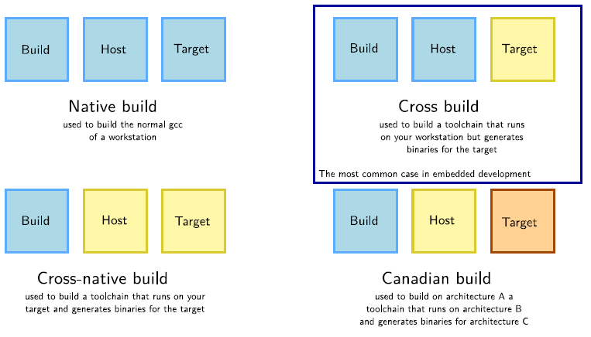
Cross-compiling toolchains Definition
Kind of toolchain:

Slide 10
Cross-compiling toolchains components
Binutils
Kernel headers
C/C++ libraries
GCC compiler
GDB debugger

Slide 11
Cross-compiling toolchains components
Consisted part :
Binutils: generate and manipulate binaries for given CPU architecture.
Kernel header: are extract from kernel sources, use to call kernel to interact with C library or application.
GCC: compile many language like C, C++,… and generate code to ASM.
C library: use to interface between application and the kernel, well-know standard C API to ease application development.
=> Application call C library and then C library link to Kernel header to interface with kernel. Final GCC compile code to ASM and the binutils generate it to binary.

Slide 12
Bootloaders Boot sequence
A piece of code
Bootloaders
Stored in ROM
Was loaded by boot code (CPU’s ROM)

Slide 13
Bootloaders Boot sequence
Bootloader is a piece of code is started by hardware, responsible for basic initialization, loading and executing the kernel.
Basic hardware initialization
Role of bootloaders
Loading of an application binary, usually an operating system
Decompression of the application binary
Execution of the application

Slide 14
Bootloaders Boot sequence
Bootloaders on BIOS-based x86: store in ROM, hardware initialization, can be loaded directly from a normal filesystem.
Bootloaders on x86: can read many filesystem: load the kernel image, the configuration, provide shell with various commands,…
Bootloaders on embedded CPUs:
Case 1: program at the address in the NOR
Case 2: CPU integrated boot code in ROM: Load in SRAM
- First stage bootloader initialize DRAM, hardware devices
- Second stage bootloader load in RAM
Physical
memory
Execution
NOR
RAM

Slide 15
Bootloaders The u-boot bootloader
U-boot:
Universal bootloader by Denx, the de-facto standard nowadays.
Typical free software project.
License: GPLv2
Usually be installed in flash memory, be executed by hardware.
U-boot configuration:
Define the GPU type, the peripherals, the memory mapping,…
Migrating from board configuration defined in header files to defconfig like in the Linux kernel.

Slide 16
Bootloaders The u-boot bootloader
U-Boot must usually be installed in flash memory, there have many way to install U-Boot depending on the hardware.
U-Boot must be configured before being compiled.
Compile U-Boot, by specifying the cross-compiler prefix.
U-Boot can be configured through environment variables.
U-Boot commands example:
Bootz <address>: starts a kernel image loaded at the given address in RAM
printenv: Show all environment variable
printenv <var-name>: Show variable's value
setenv <var-name> <var-value>: Change variable value
editenv <var-name>: Edit variable's value
saveenv: Save current environment's state to flash

Slide 17
Bootloaders The u-boot bootloader
Scripts in environment variables: can contain small scripts, execute several command and test the results of command.
Transferring files to the target: files exchanged between the target and the development workstation through Ethernet connection, USE key, SD or microSD card or serial port.
TFTP(Trivial Transfer Protocol): Net transfer from the development workstation to U-Boot on the target.

Slide 18
Linux kernel introduction
Linux kernel is one of component of system, which also require libraries and applications to provide features to end users.
Linux kernel and key features:
Portability and hardware support.
Scalability.
Compliance to standards and interoperability.
Exhaustive networking support.
Security.
Stability and reliability.
Modularity.
Easy to program.

Slide 19
Linux kernel introduction
Manage all the hardware resource: CPU, memory, I/O
Embedded System
Application
Linux kernel main role
Portable, architecture, hardware independent APIs
Library
Even notification
Information exposition
Call to service
Linux kernel
Handle concurrent access and usage
Manage hardware
Even notification
Bootloader

Slide 20
Linux kernel introduction
System calls: interface between the kernel and user space, only system calls can be added by the kernel developers, system calls interface is wrapped by the C library.
Pseudo filesystems: the space that Linux makes file system and kernel information, allow applications directories and files that do not exist on any real storage, separate into two most important:
proc: operating system related information( processes, memory,…)
sysfs: set of devices and buses of system.
Linux license: free software released under the GNU.
Support hardware architecture: minimum 32 bit processors, with or without MMU, and gcc support.

Slide 21
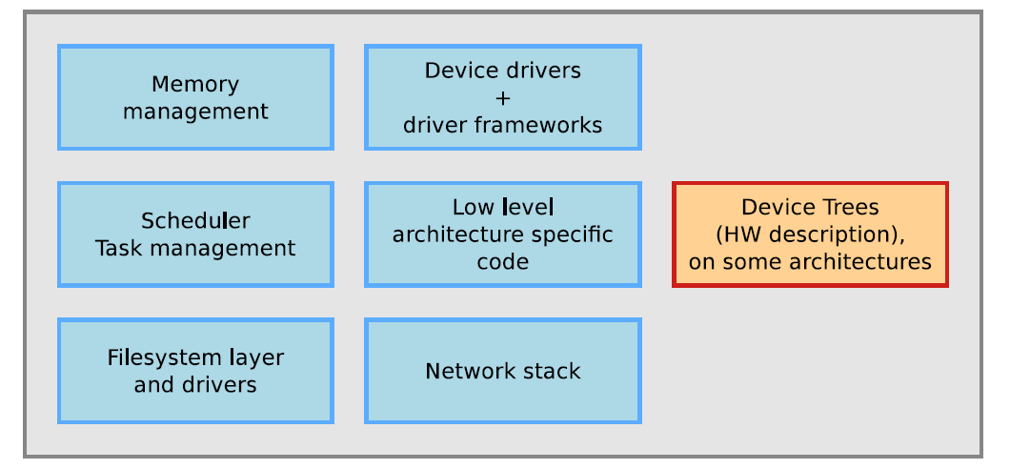
Linux kernel Architecture

Slide 22
Linux kernel Linux Kernel source
Many chip vendors supply their own kernel source
Many kernel sub-communities maintain their own kernel, with usually newer but less stable features.
The git version control system have needed for kernel development.

Slide 23
Linux kernel Kernel configuration
The kernel configuration is the process of defining the set of options with which you want your kernel to be compiled.
The kernel configuration and build system is based on multiple Makefiles.
The kernel configuration stored in the .config file at the root of kernel sources.
The kernel image is a single file, some features(device driver, filesystems,…) can however be compiled as modules.
Kernel option dependencies:
depends on dependencies: option A that depends on option B is not visible until option B is enabled
select dependencies: option A depending on option B, when option A is enabled, option B is automatically enabled.
make xconfig allows to see all options.

Slide 24
Linux kernel compiling and installing the kernel for the host system
Use:
make: in the main kernel source directory, no need to run as root.
make install: does the installation for the host system by default, need to be run as root.
make clean: Clean-up generate files.
make mrproper: Remove all generated files.
make distclean: Remove editor backup and patch reject files.
git clean –fdx: Remove all file not tracked when we are in git tree.

Slide 25
Linux kernel Cross-compiling the kernel
Compile Linux kernel for another CPU architecture: much faster than compiling natively, much easier, cross-compiler executables are prefixed by the name of the target system.
The CPU architecture and cross-compiler prefix are defined through the ARCH and CROSS_COMPILE variable in the top level Makefile:
ARCH: Name of architecture, defined by the name of subdirectory in arch/ in the kernel source.
CROSS_COMPILE : the prefix of the cross compilation tools.
The kernel command line is a string that defines various argument to the kernel.
The kernel command line is passed by the bootloader, built into the kernel, using CONFIG_CMDLINE option

Slide 26
Linux kernel Using kernel modules
Advantages of modules:
Easy to develop drivers without rebooting: load, test, unload,..
Keep the kernel image size to the minimum.
Useful to reduce boot time.
Kernel log:
Keep its messages in circular buffer.
Available through the dmesg command.
Displayed in the system console.

Slide 27
Linux kernel Using kernel modules
Kernel utilities: <module_name>: name of the module file without the trailing.
modinfo <module_name>: gets information about a module without loading it: parameters, license, description and dependencies.
sudo insmod <module_name>: tries to load the given module.
sudo modprobe <module_name>: tries to load all the modules the given module depends on.
lsmod: displays the list loaded modules.
sudo rmmod <module_name>: tries to remove given module.
sudo modprobe –r <module_name>: tries to remove module and all dependent modules.
modifo usb-storage: find available parameters.
When driver is built statically into the kernel: usb-storage.delay_use=0

Slide 28
Linux root filesystem principle and solutions
Organize data in directories and file on devices or on the network
File system
Allows applications to access file and directory easily
Mounted
Mounted in a directory → contents
of the storage device
Specific location
Unmounted → mount point is empty
In Unix systems, Applications and users see a single global hierarchy of file and directories, which can be composed of several filesystems.

Slide 29
Linux root filesystem principle and solutions
Create a mount point: mkdir /mnt/usbkey
It is empty: ls /mnt/usbkey
Mount a storage device in this mount point: mount –t vfat /dev/sda1 /mnt/usbkey
mount : allows to mount filesystems
example: mount –t type device mountpoint
unmount: allows to unmount filesystems(needed before rebooting, unplugging a USBkey)
Directory where files of storage device or network location
Storage device or network location
Type of file system

Slide 30
Linux root filesystem principle and solutions
Filesystem is mounted at the root of the hierarchy, identified by /. This filesystem is called the root fileststem
When no root filesystem is available, the kernel panics.
Root file system can be mounted from different locations:
From the partition of a hard dish
From the partition of a USB key
From the partition of an SD card
From the partition of a NAND flash chip or similar type of storage device.

Slide 31
Linux root filesystem principle and solutions
Mounting rootfs over the network: when networking works, root filesystem could be a directory on your GNU/Linux development host, exported by NFS.
Host
NFT server
Ethernet
Target
NFT client
Built into the kernel
Install NFS server
Add the exported to /etc/exports file
Start or restart NFS server
Compile kernel with NFS support, configure IP at boot time.
Kernel must be booted with rootfs over NFS, target IP address and NFS server details

Slide 32
Linux root filesystem principle and solutions
Rootfs in memory(initramfs): root filesystem integrated into the kernel image is loaded memory together with the kernel.
Kernel kernel image(zlmage, bzlmage,…)
Kernel code and data
Root filesystem stored as a compressed cpio archive

Slide 33
Linux root filesystem contents
List of important directories:
/bin Basic programs
/boot Kernel image
/dev Device files
/etc System-wide configuration
/home Directory for the users home directories
/lib Basic libraries
/media Mount points for removable media
/mnt Mount points for static media
/proc Mount point for the proc virtual filesystem
/root Home directory of the root user

Slide 34
Linux root filesystem contents
List of important directories:
/sbin Basic system programs
/sys Mount point of the sysfs virtual filesystem
/tmp Temporary files
/usr/bin Non-basic programs
/usr/lib Non-basic libraries
/usr/sbin Non-basic system programs
/var Variable data files

Slide 35
Linux root filesystem device files
In the Linux kernel, most devices are presented to user space applications through two different abstractions:
Character device: an infinite stream of bytes, with no beginning, no end, no size; used for serial ports, terminals, video acquisition,…
Block device: a device composed of fix sized blocks, user for hard disk, USB keys,…
All device files are by convention stored in the /dev directory.

Slide 36
Linux root filesystem Pseudo filesystems
The proc virtual filesystem exists since the beginning of Linux:
Allow the kernel to expose statistics about running processes in the system.
Allow the users to adjust at runtime various system parameters about process management, memory management.
Command to mount /proc: mount –t proc nodev /proc.
sysfs filesystem allows to represent in user space the vision that the kernel has of the buses, devices and drivers in the system.
All application using sysfs expect it to be mounted in the /sys directory

Slide 37
Linux root filesystem minimal filesystem
Bootloader
Loads the kernel to Ram and starts it
Overall booting process
KERNEL
Initializes hardware devices, kernel subsystem
Mounts the root filesystem
Start the init application, sbin/init by default
ROOT FILESYSTEM
/sbin/init

Slide 38
Linux root filesystem minimal filesystem
Bootloader
Loads the kernel to Ram and starts it
Overall booting process with initramfs
KERNEL
Initializes hardware devices, kernel subsystem
Extracts the initramfs archive to the file cache
Start the /init executable if found
INITRAMFS
/init
ROOT FILESYSTEM
/sbin/init

Slide 39
Block filesystems Block devices
Storage devices
Block devices
Flash device
Block device: can read and written to on a per-block basic, in random order, without erasing: Hard disks, floppy disks, RAM disks, list of block device available in the system: /proc/partitions or /sys/block
Raw flash devices: be driven by a controller on the SoC, it can read but writing requires erasing and often occurs on a larger size than the “block” size, include NOR flash, NAND flash.

Slide 40
Block filesystems Block devices
Block devices can be partitioned to store different parts of a system.
The partition table is stored inside the device itself, it is read and analyzed automatically by the Linux Kernel.
Two partition table formats:
MBR, the legacy format
GPT, the new format, becoming more and more common.
Numerous tools to create and modify the partitions on a block device: fdisk, cfdisk, sfdisk, parted,…

Slide 41
Block filesystems available filesystems
The standard filesystem used on Linux systems is the series of ext{2,3,4} filesystems.
Designed to stay in coherent state even after system crashes or sudden poweroff.
Writes are first described in the journal before being committed to files.
Application
Use space
Write to file
Kernel Space
Write to file
Write an entry in the fournal
Clear journal entry.

Slide 42
Block filesystems available filesystems
Reboot
File system recovery after crashes:
Journal empty?
No
Discard incomplete journal entries
Yes
Execute journal
Filesystem OK

Slide 43
Block filesystems available filesystems
Other Linux/Unix filesystems:
btrfs: intended to become the next standard filesystem for Linux.
XFS: high-performance filesystem inherited from SGI IRIX.
JFS: inherited from IBM AIX.
reiserFS
Filesystem for flash-based storage(F2FS): takes into account the characteristics of flash-based storage: eMMC, SD card, SSD,… Developed and contributed by SamSung.
Read-only(Squashfs): compressed filesystem for block device.
Filesystem in RAM(tmpfs): not a block filesystem of course, perfect to store temporary data in RAM: system log files, connection data,…

Slide 44
Block filesystems available filesystems
Compatibility filesystems:
vfat: compatibility with FAT filesystem used in the Windows(can not use Linux root filesystem)
ntfs: compatibility with the the NTFS filesystem used on Windows
hfs: compatibility with HFS filesystem used on Mac OS.
Iso9660: the filesystem format used on CD-ROMs, obviously a read-only filesystem.

Slide 45
Block filesystems Using block filesystems
Create an empty ext2/ext3/ext4 filesystem:
mkfs.ext2 /dev/hda3
mkfs.ext3 /dev/sda2
mkfs.ext4 /dev/sda3
mkfs.ext2 disk.img
Create a filesystem image from a directory containing all our files and directories: genext2fs -d rootfs/ rootfs.img
Creating squashfs filesystem: install squashfs-tools package, mounting a squashfs filesystem: mount –t squashs /dev/<device> /mnt

Slide 46
Block filesystems Using block filesystems
squashf
Read-only compressed root filesystem
Mixing read-only and read-write filesystems:
A compressed read-only partition(squashfs)
A read-write partition with a journaled filesystem( like ext3)
RAM storage for temporary files (tmpfs).
Flash storage available only through a block interface.
Block storage
Ext3
Read-write user and configuration data
tmpfs
Read write volatile data
RAM

Slide 47
The end

Slide 48
www.renesas.com

